Slide 1
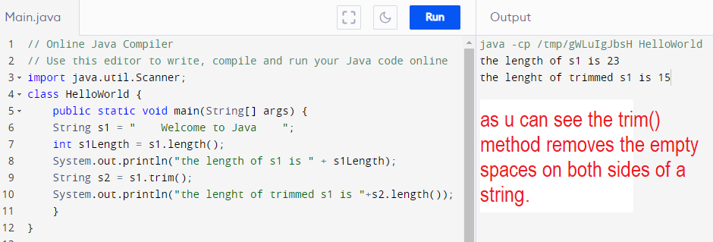
The .trim() method

Slide 2
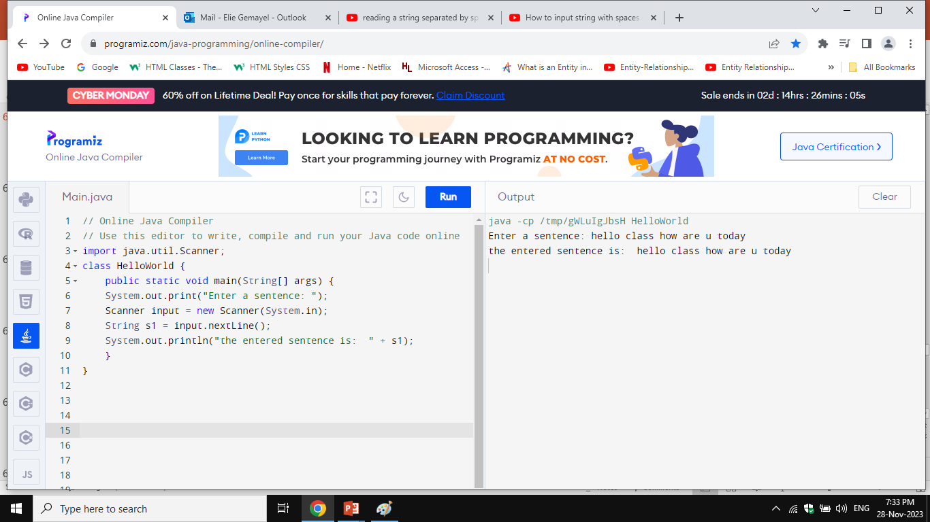
String Scanner
Reading a String from the Console

Slide 3
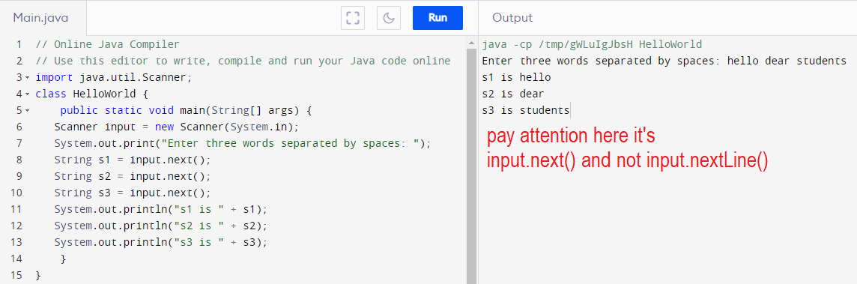
Reading Multiple Strings from the Console

Slide 4
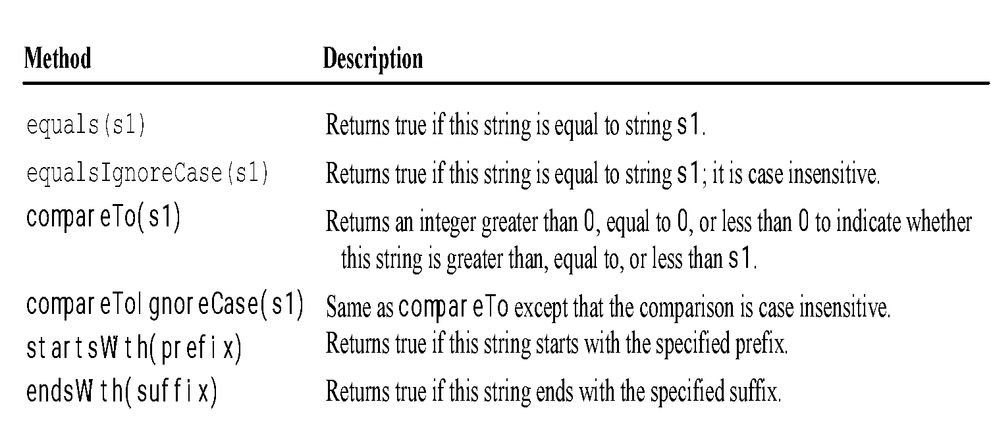
Comparing Strings
You don’t have to memorize it all .We will stick to the .isEqual() method only.

Slide 5
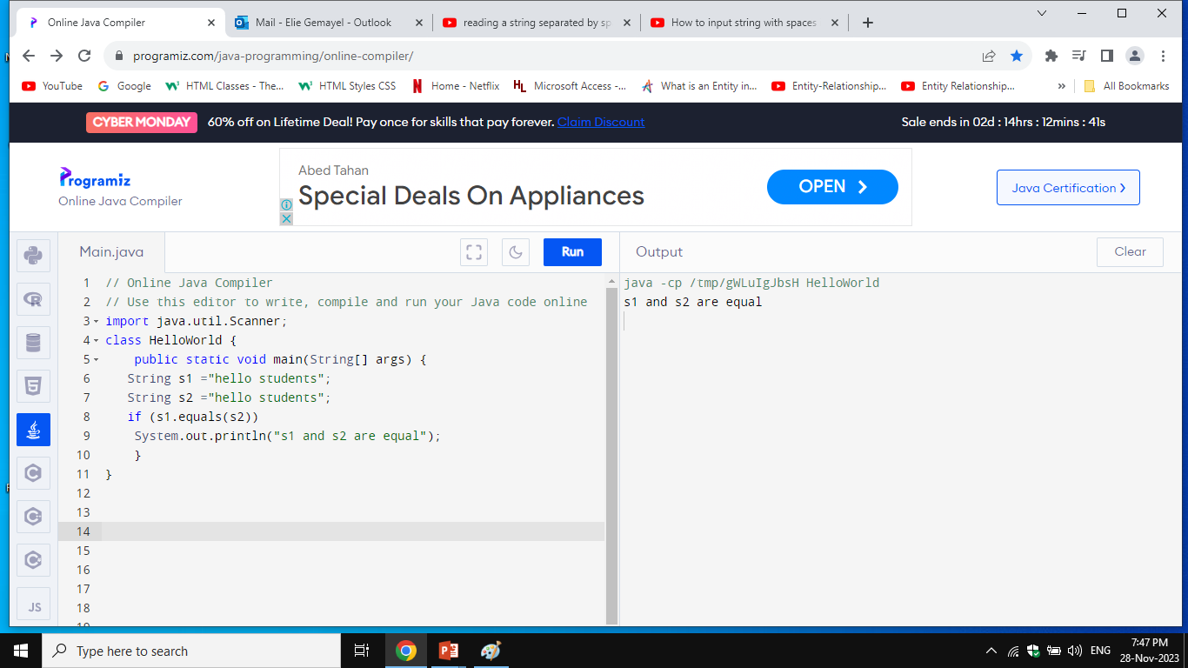
.isEqual() method
Syntax : s1.isEqual(s2)

Slide 6
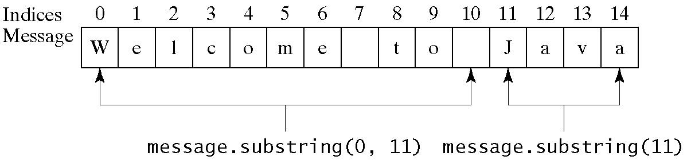
Obtaining Substrings from strings
Syntax:
S1.substring(begin index) ex S1.substring(3)
this method retrieves a substring from s1 starting with letter index 3
S1.substring(begin index, end index) ex S1.substring(0,6)
this method retrieves a substring starting with letter index 0 to 5
N.B 5 not 6.

Slide 7
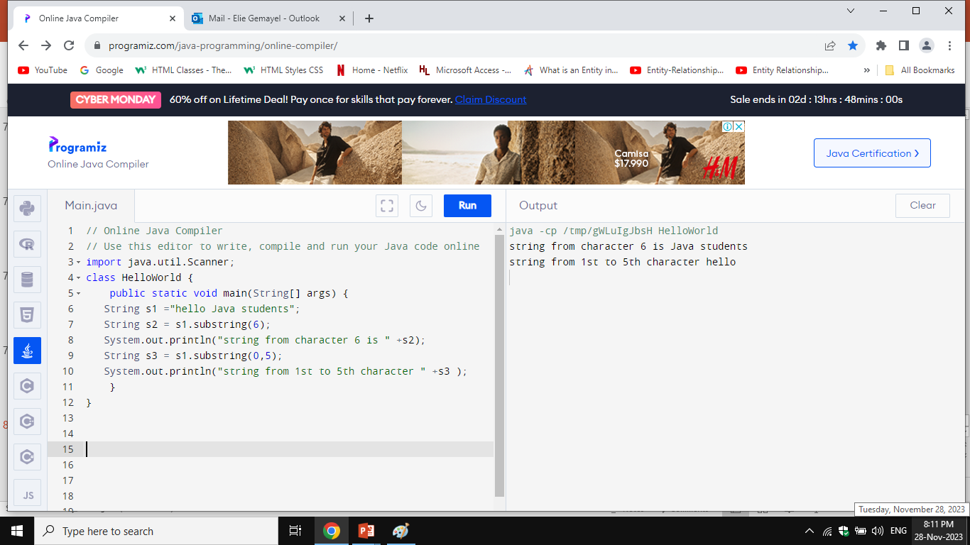
Obtaining Substrings from strings

Slide 8
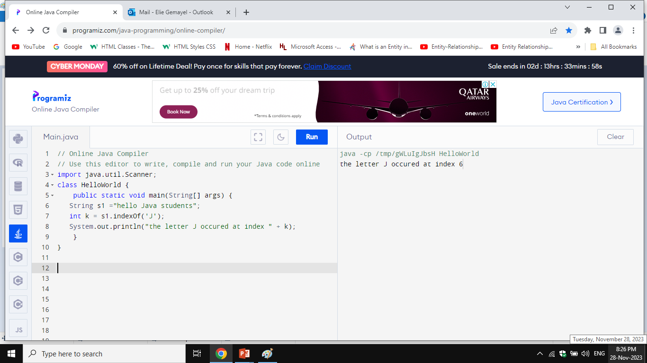
Finding character index in a String
.indexOf(‘ ’)
Int k = s1.indexOf(‘J’)
The following method returns the index of the first occurrence of the letter J inside string s1.The index is an integer so it will be put inside the k int variable.

Slide 9
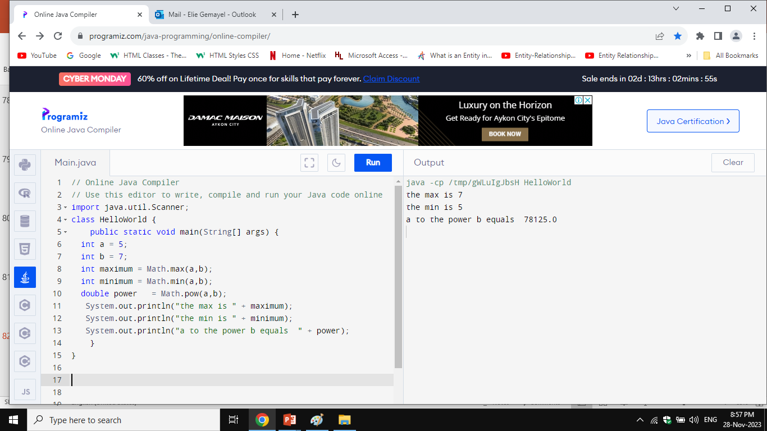
The Math Class Min ,MAX and Power
Syntax : Math.max(a,b) and Math.min(a,b) and Math.pow(a,b)

Slide 10
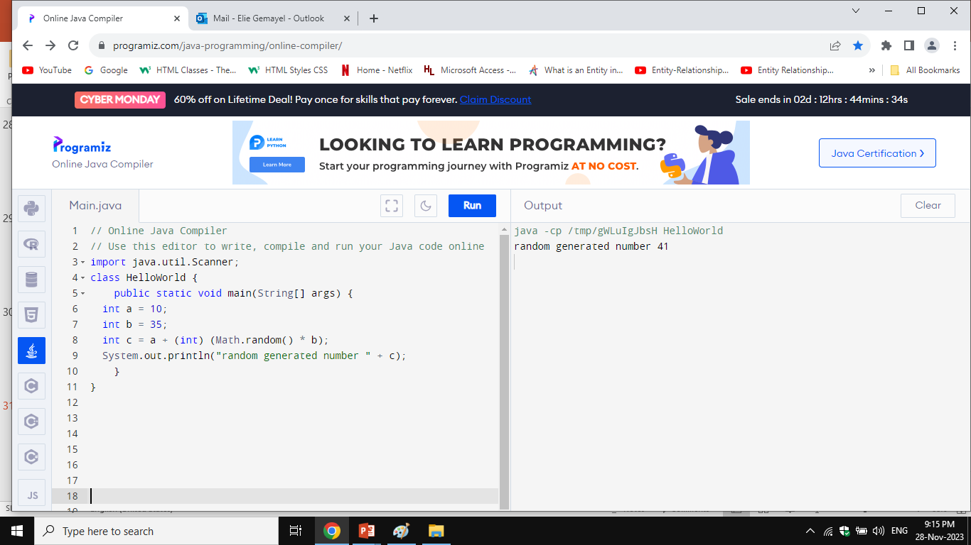
Random number generator
a <= random generated number < a+b

Slide 11
Loops
Motivations:
Suppose that you need to print a string (e.g., "Welcome to Java!") a hundred times. It would be tedious to have to write the following statement a hundred times:
System.out.println("Welcome to Java!");
So, how do you solve this problem?

Slide 12
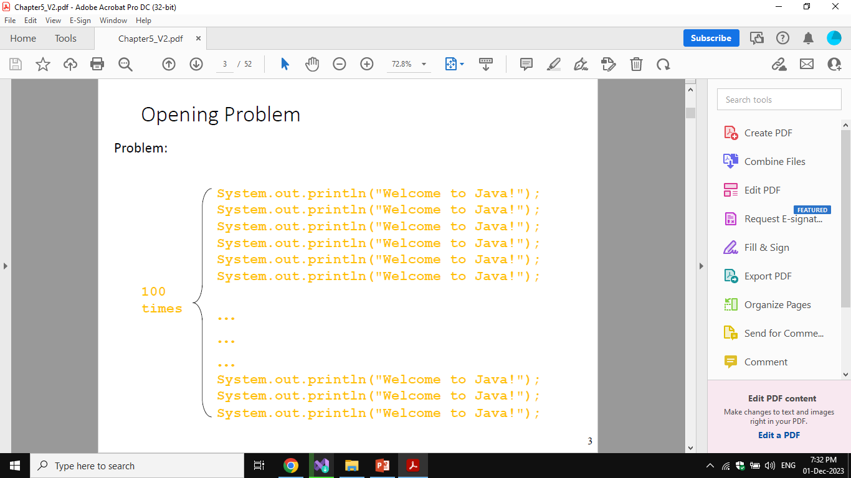
Opening Problem

Slide 13
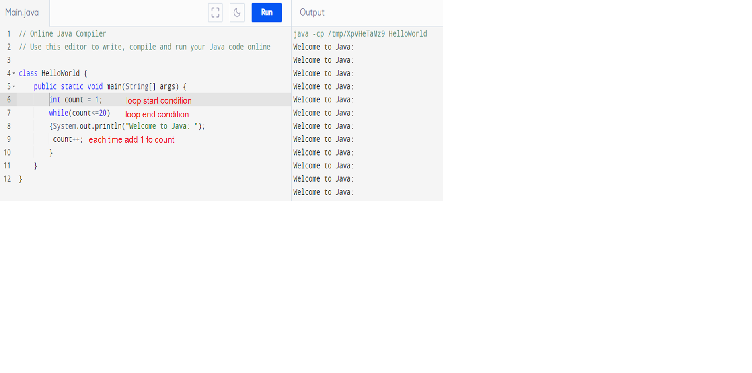
While Loop Sequence

Slide 14
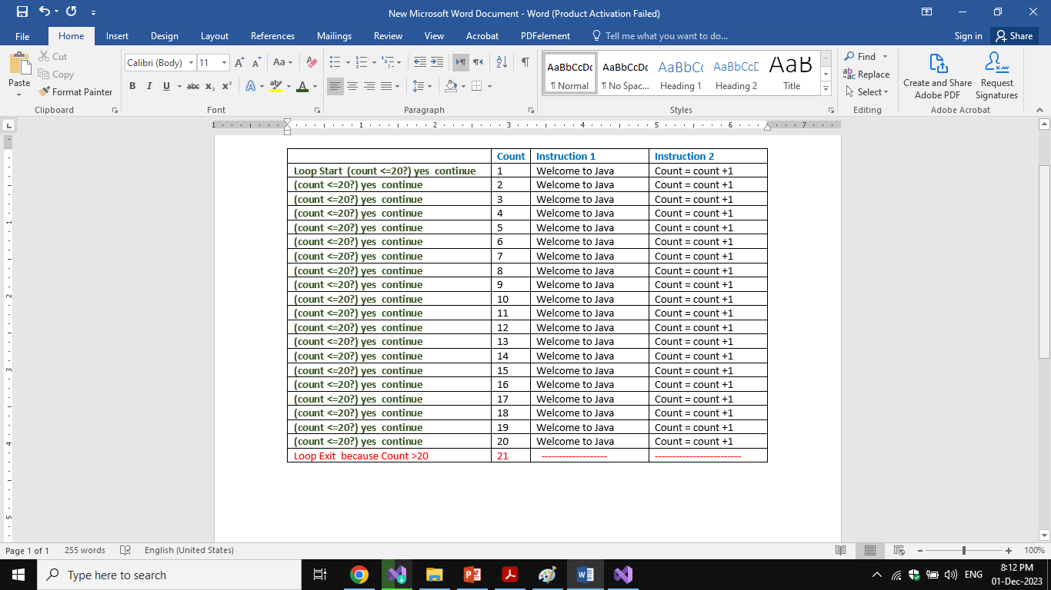
While Loop Sequence

Slide 15
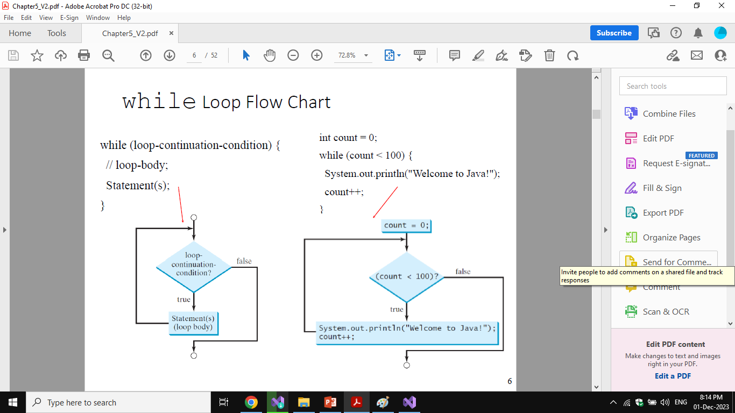
While Loop Flow Chart

Slide 16
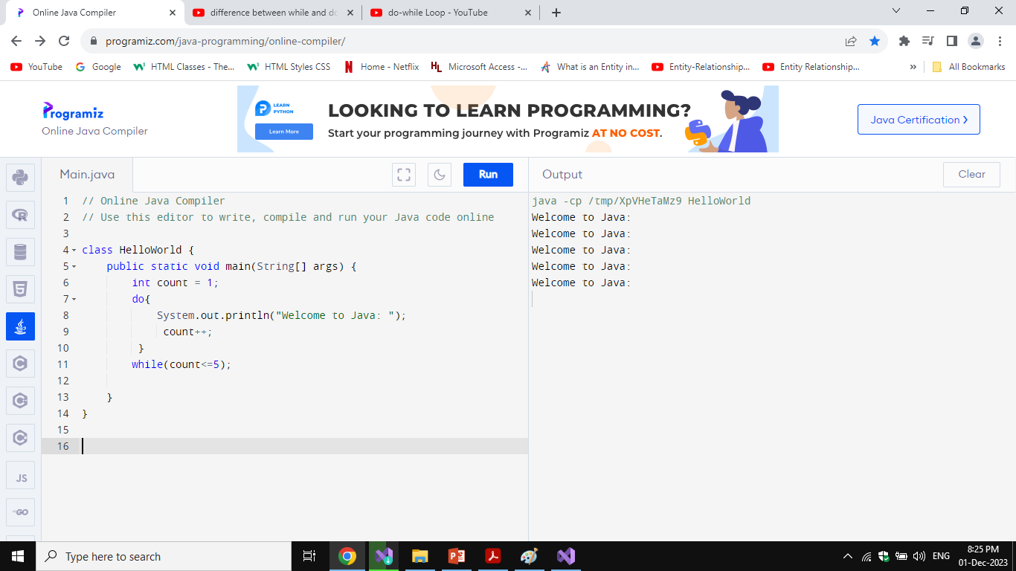
The Do While Loop

Slide 17
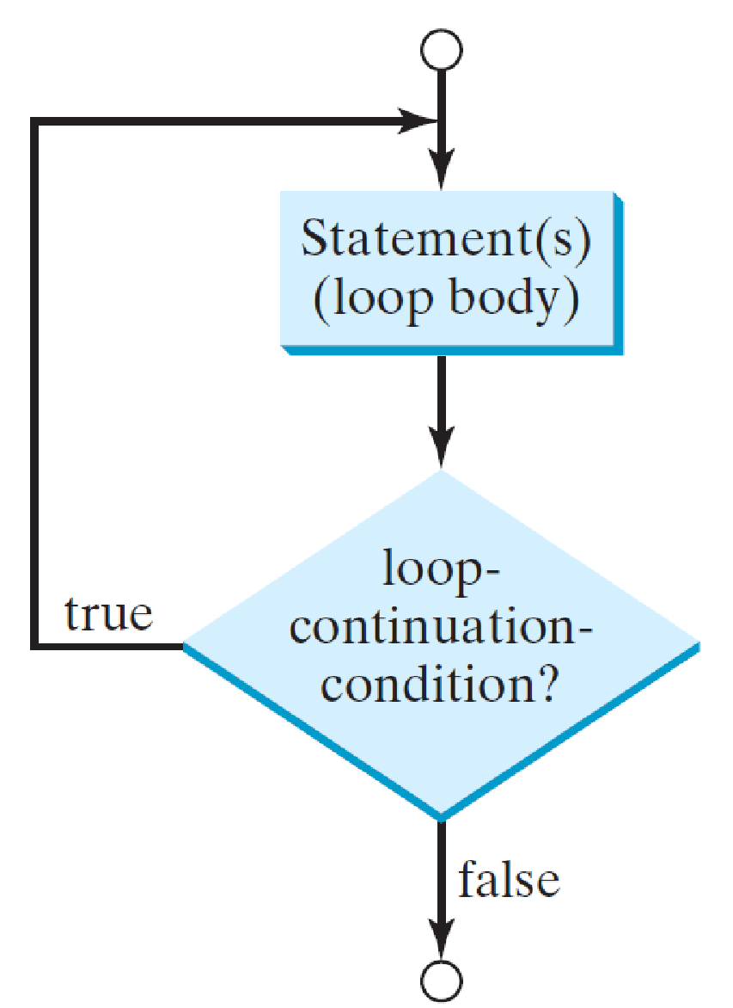
Do While Loop Flow Chart

Slide 18
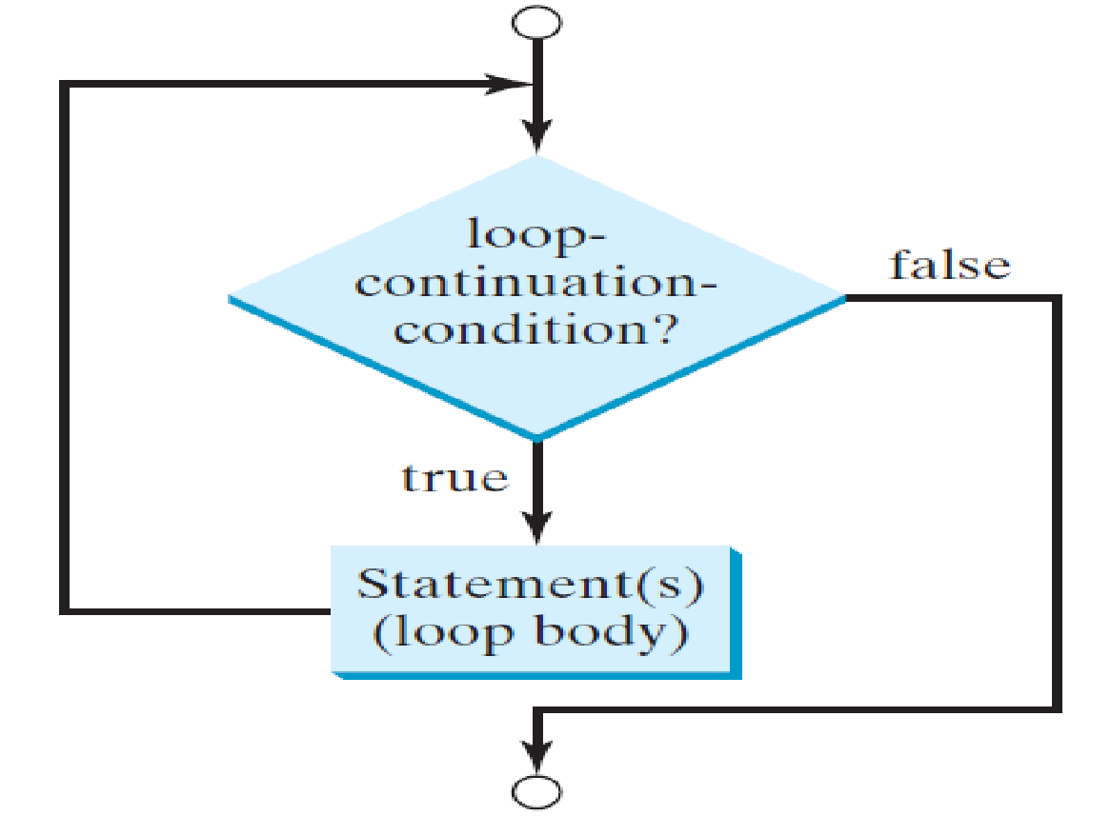
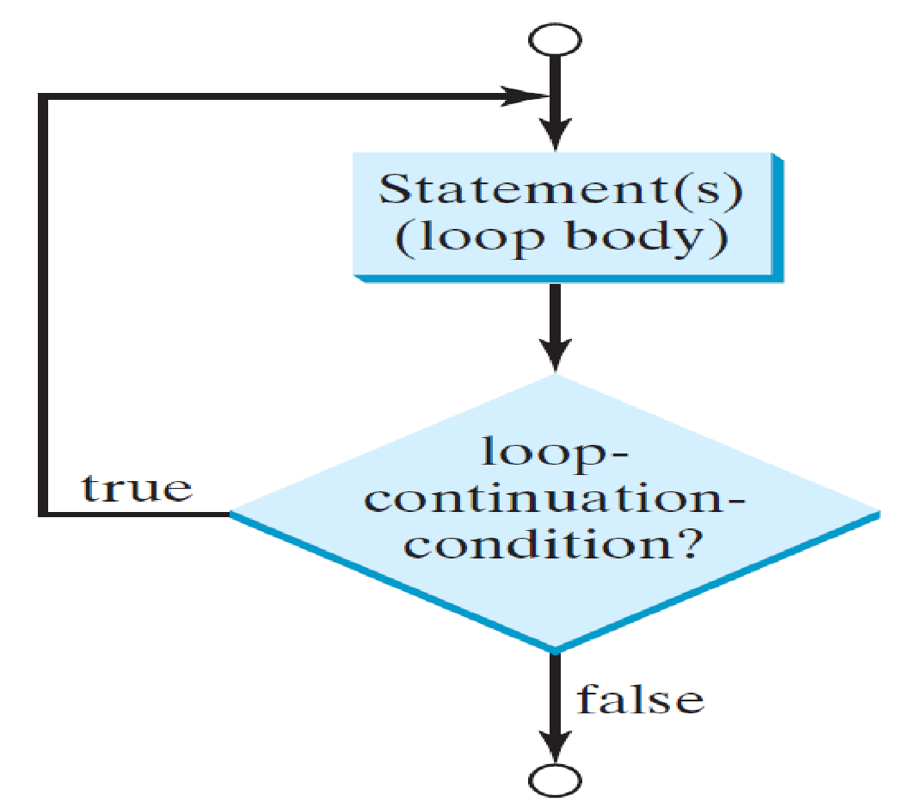
Difference between While and do while
In while loop we first check the condition and then execute the statements.
In do while loop we execute the statement then check the condition.
N.B a ; is needed after while in (do while) . No need for ; after while in (while)
while loop do while loop

Slide 19
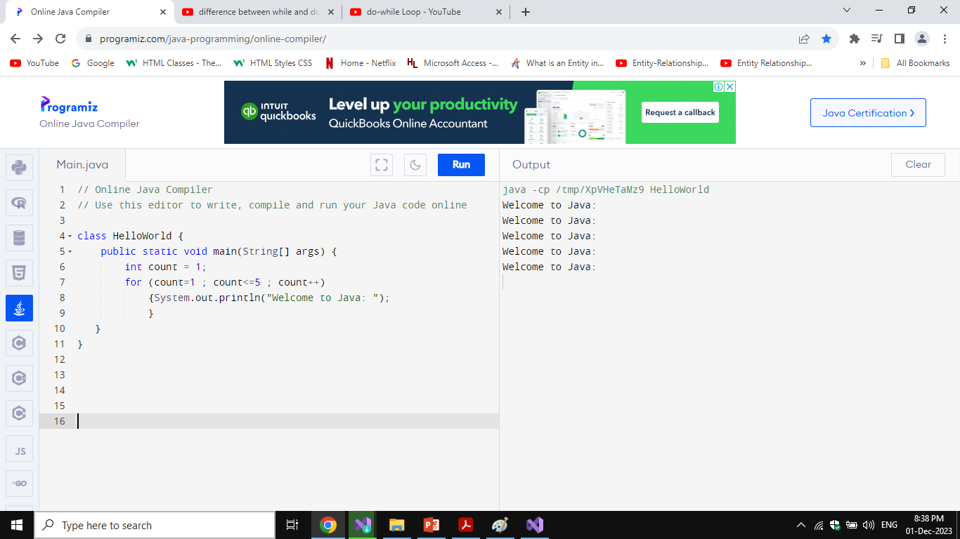
The for Loop
Syntax : for (start condition; loop-continuation-condition; action)
Ex: for (count=1 ; count<=5 ; count++)
{System.out.println("Welcome to Java: ");}
N.B: the for loop will break when count =6

Slide 20
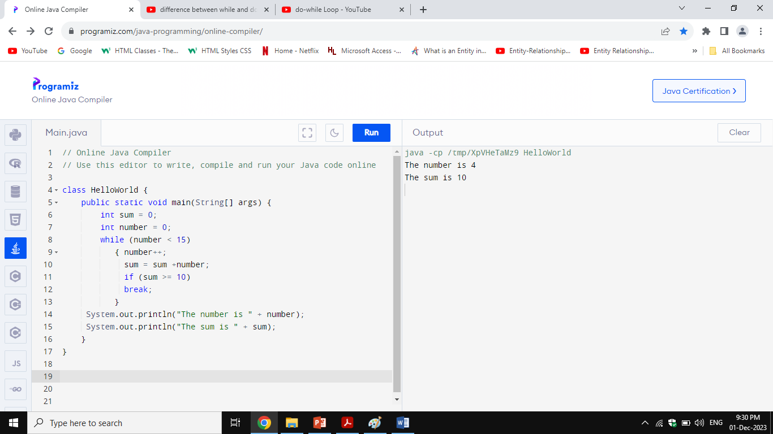
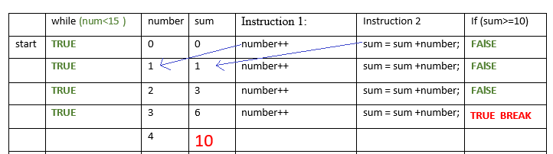
Break;

Slide 21
Single-Dimensional Arrays
Opening Problem
Read one hundred numbers, compute their average, and find out how many numbers are above the average.
We need an array to do that.

Slide 22
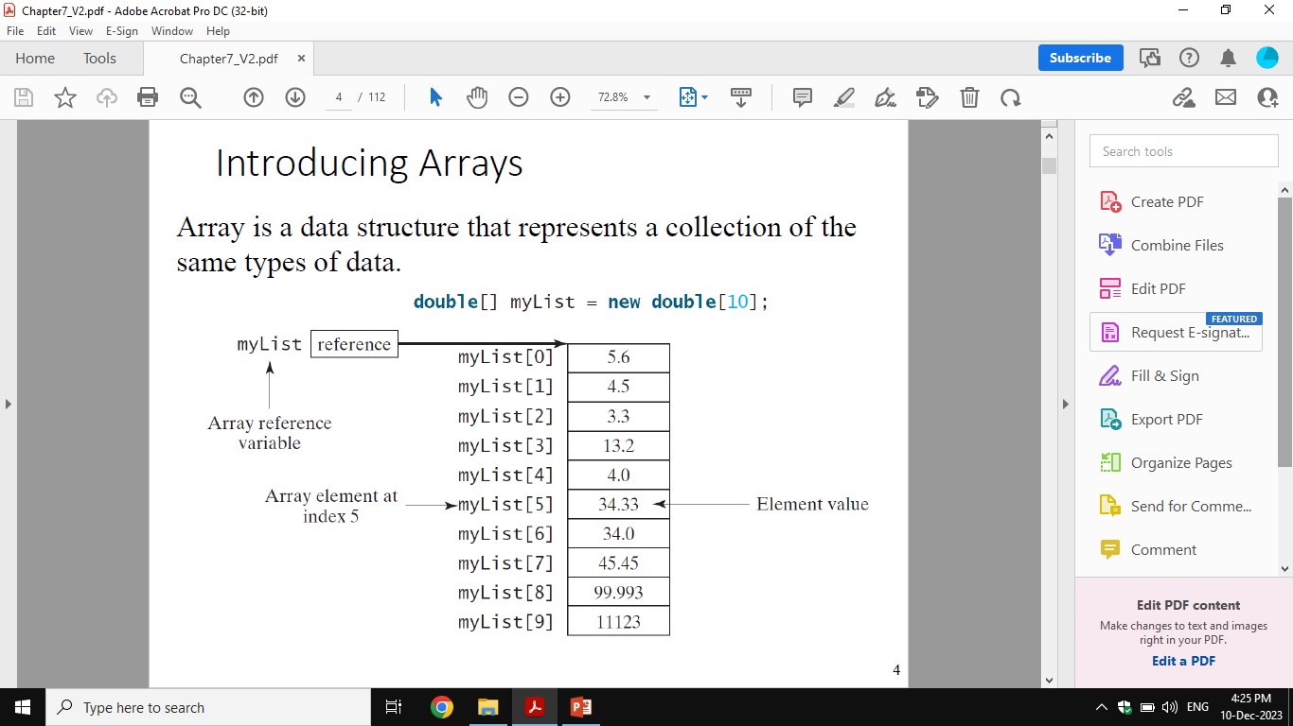
Introducing Arrays

Slide 23
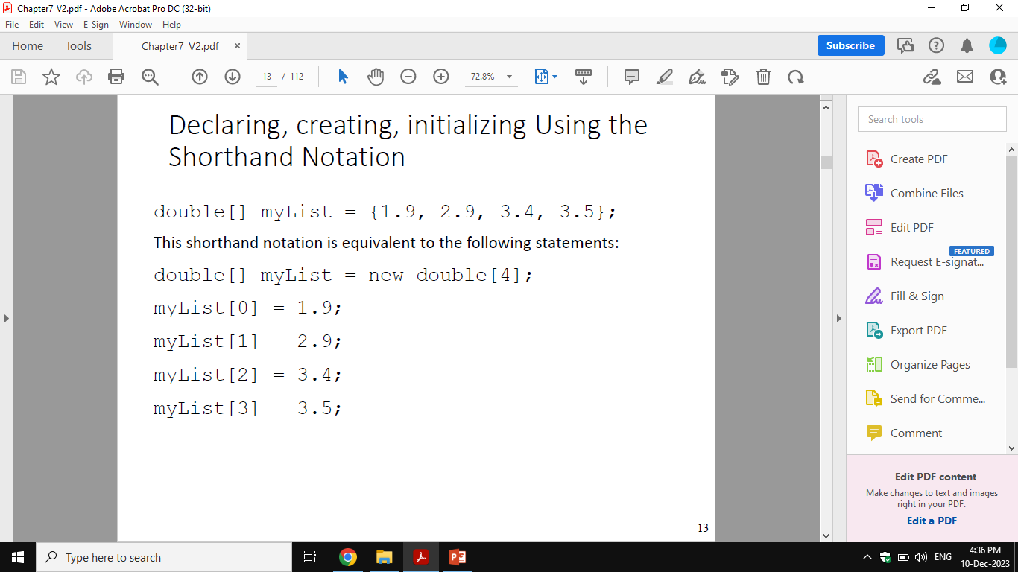
Creating Arrays
Example:
myList= new double[10];
myList[0]references the first element in the array.
myList[9]references the last element in the array
Example:

Slide 24
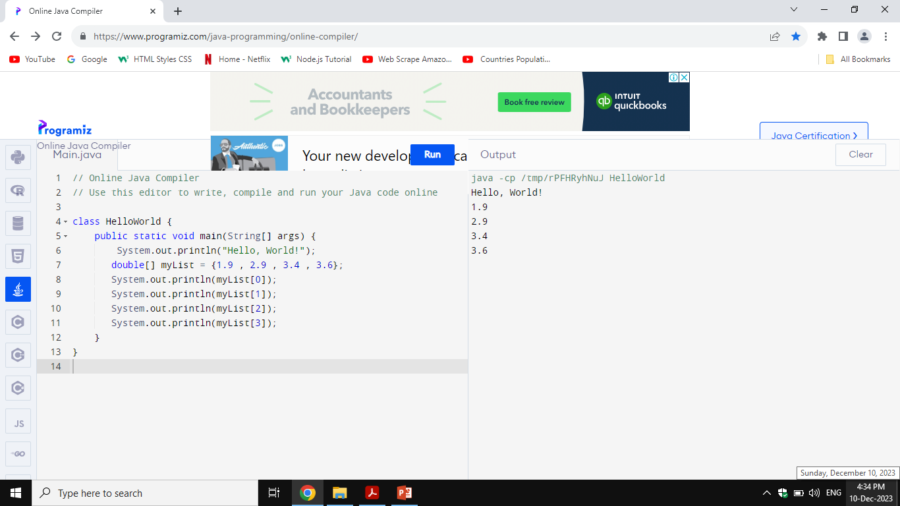
Example with JAVA

Slide 25
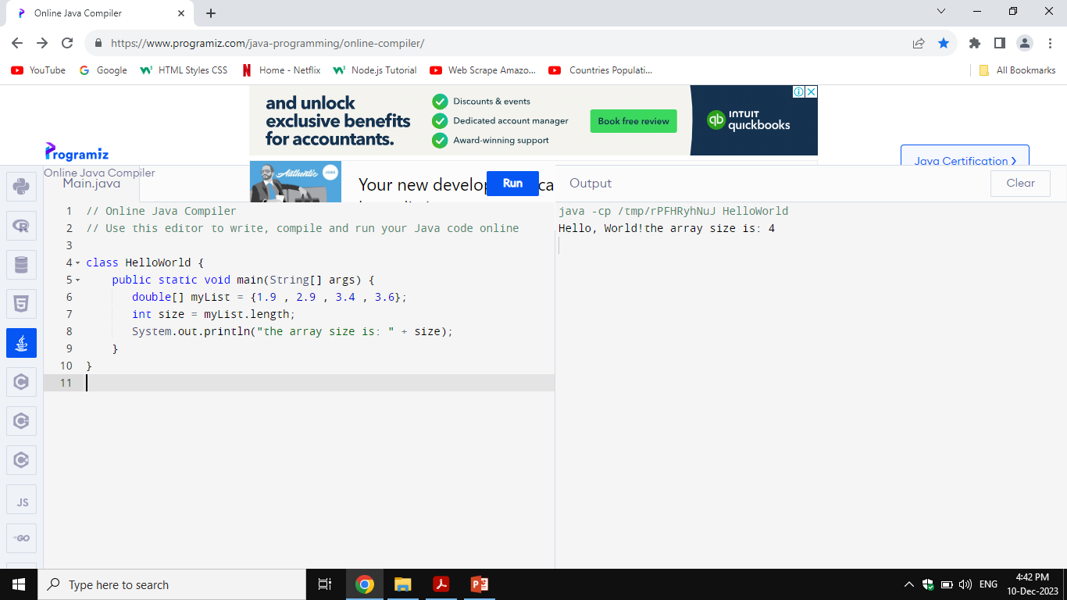
Array length

Slide 26
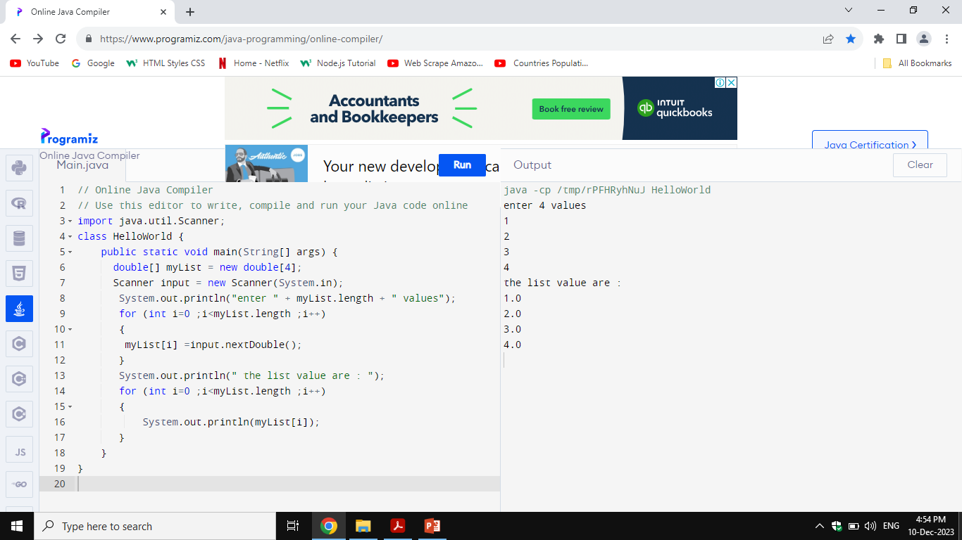
Scanner for array values

Slide 27

Find the MAX value in array

Slide 28
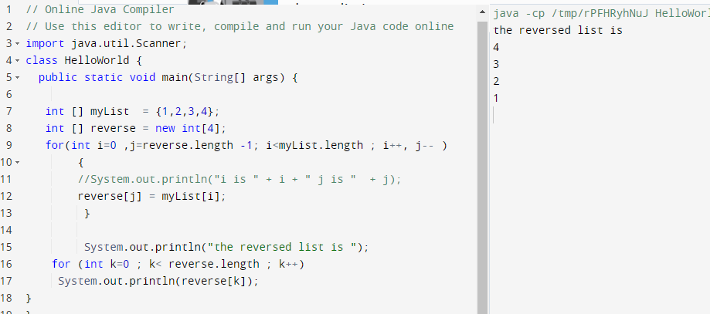
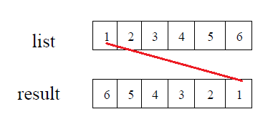
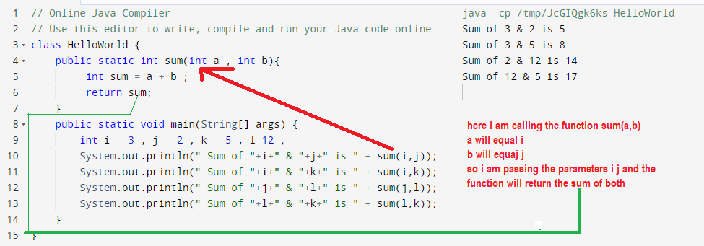
Reverse an array

